Slide 1
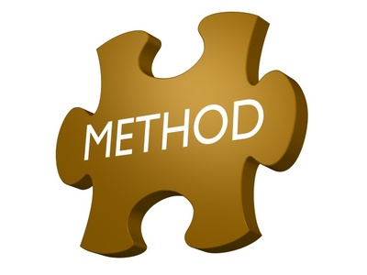
An overview of foresight methods
Maree Conway
Thinking Futures/
Centre for Australian Foresight
August 2013
Notes:
Good morning from Australia.
This is Maree Conway, and welcome to this webinar today which will provide you with an overview of foresight methods.
The content block is about 30-35 minutes, and we will then have time for questions and discussion.
You should be able to see a chat box on your screen, and a button marked Q&A – click on that and ask questions as they occur to you – I’ll answer them if I can during the webinar, otherwise we will get to them at the end.
Okay, let’s get started.

Slide 2
Overview
Context: why foresight?
Methods Framework – the Generic Foresight Process
Input Methods
Analytical Methods
Interpretation Methods
Prospective Methods
Back to Work: which methods and when?
Questions/Discussion

Slide 3
Context: why foresight?
Notes:
Before we get to the methods, it’s important to spend a little time on the broad context – why do foresight work in the first place?
I knew nothing about foresight in a strategic sense until 1999 when the then VC of Swinburne University of Technology where I was then working asked me to ‘do’ foresight. After googling it when I went back to my office, working to implement it at Swinburne and eventually leaving Victoria University in 2007, I can safely say that doing foresight changed my life – not only my career, but how I think.
That’s a conversation for another day, the key point is that foresight allows you to see the world through different filters, different lenses and to think differently about the future.

Slide 4
Context: why foresight?
Future
We need to learn from the future to avoid making mistakes
Uncertain – it hasn’t happened yet
Can shape and influence
No data
Macrohistory – cycles of change
Moving - things are changing constantly
Can respond, shape and influence
Data overload
Present
Using the past and the future to inform strategic decisions today
Certain in terms of what happened
Can’t change
Much data
Past
We learn about the past to avoid repeating mistakes today
Notes:
For me, foresight is fundamentally about understanding and responding to change in the external environment – on a continuing basis.
Macrohistory tells us that there are cycles of change – this theory operates at the meta level, it’s about taking a long term 50-100+ year view and looking for change patterns over that period. Very few of us venture into this territory and the work I do in foresight has to have a practical orientation – the thinking we do about the future has to inform decision making today.
Thinking about the future also involves the past and the present. In a time sense, these three are intertwined.
The past we can’t change and we interpret and analyse it to learn from it – to avoid making mistakes today. Unfortunately, we often seem not to be really good at doing this.
In the present, we are surrounded by change, nothing appears to stay the same for very long, and at times it is overwhelming. Depending upon when we come across the change, we can respond to it or try and shape and influence its evolution – we’ll talk about this a bit later on.
The other thing about today is that we are also overwhelmed by data. Much information, much noise. And we can come to depend on data at the expense of other sources of information.
The future, however, is uncertain. Our responses to change today are shaping and influencing the future, and we need to learn from the future to avoid making mistakes with those responses.
As human beings, we prefer certainty to uncertainty though, so we seek data to inform our decision making. Since there are no future facts, thinking about the future is often dismissed as a waste of time, although after the GFC, more people realised the value of exploring what might happen before it hits you in the face unawares.
For robust strategy to be developed, you will need to consider the past, present and future in your decision making.

Slide 5
Definition
The ability to take a forward view and use the insights gained in organisationally useful ways
Richard Slaughter, Foresight International

Slide 6
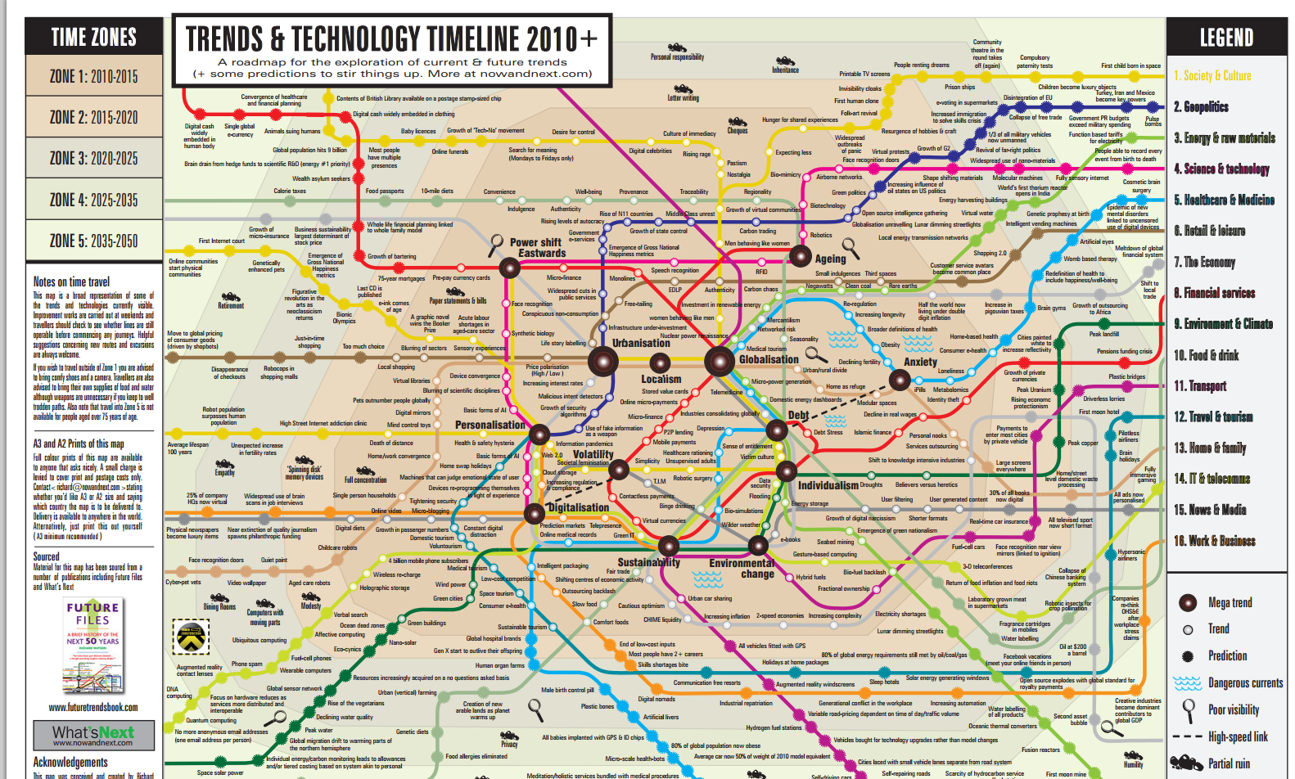
Change Ecosystem
Notes:
Foresight processes help you deal with the change ecosystem out there which looks like this.
It’s complex and not easy to understand, and we need to spend time immersed in it to identify the implications for your organisation.

Slide 7

This is a common reaction when people are asked to deal with that ecosystem in the strategy process
Notes:
We use foresight approaches to help make sense of that change ecosystem – not to stick our heads in the sand about the future, but rather to spend some time in that space.

Slide 8
Current strategy processes live in the pragmatic futures realm.
Working within the existing paradigm, making it better, but not challenging it.
We call it ‘strategic planning’.
Notes:
Unfortunately, most strategy approaches today are conventional, and don’t spend much time in the future space.
Richard Slaughter talks about three levels of futures work – pragmatic, progressive and civilisational.
What we call strategic planning now is in the pragmatic realm – where we try to improve how we do things, but we don’t challenge what we do. We are planning for more of the same.

Slide 9
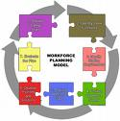
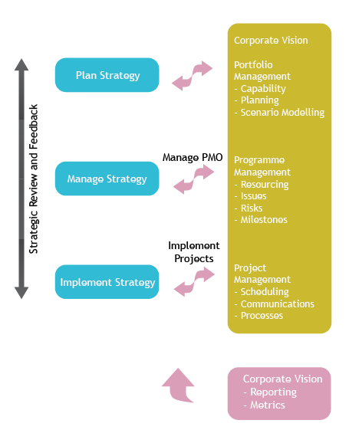
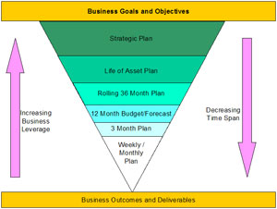
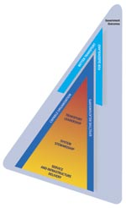

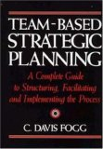
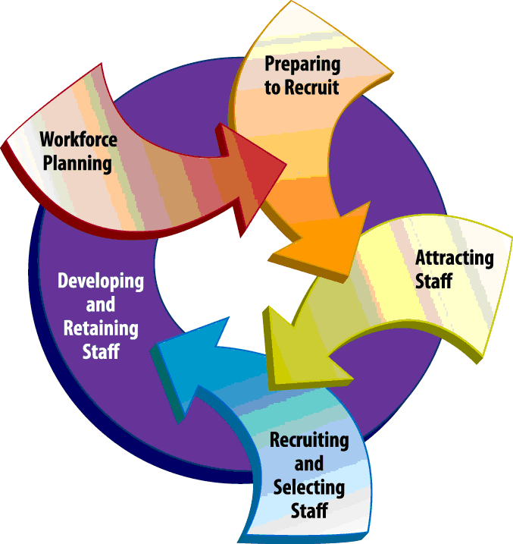
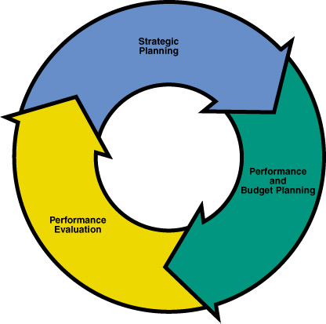
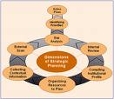
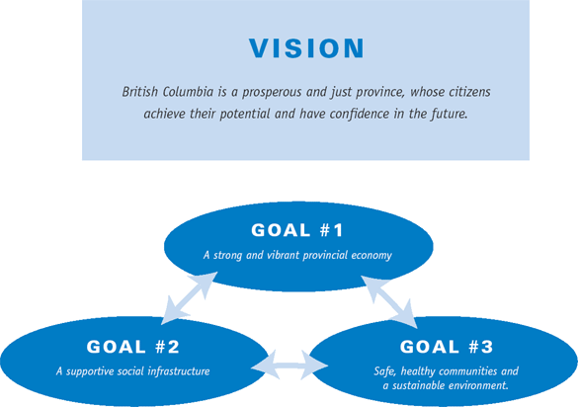
Notes:
These sorts of diagrams abound when we look at strategic planning.
The conventional approaches to strategic planning are familiar but often produce less than useful plans because of a number of reasons:

Slide 10
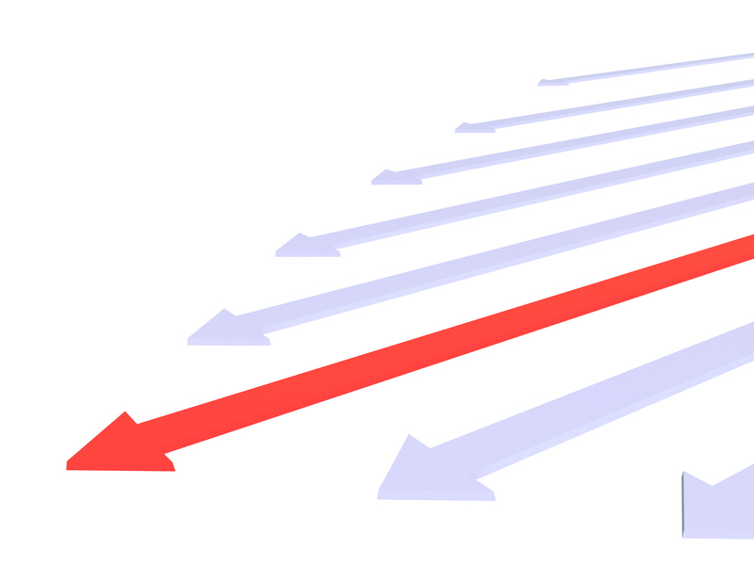
Think tomorrow is going to be more of today, and assume a linear future
Notes:
Develop a single ‘default future’ which is usually a linear extrapolation of today.

Slide 11

Are not prepared for the unexpected or the unfamiliar
Notes:
Because they are fixed, plans often lack the flexibility to deal with unexpected changes in the external environment.

Slide 12

Usually don’t systematically and deeply explore the long term future (10-20 years out) to identify possible futures
Notes:
Usually don’t include any processes for systematically exploring the long term future of the organisation – think beyond 5 years.

Slide 13
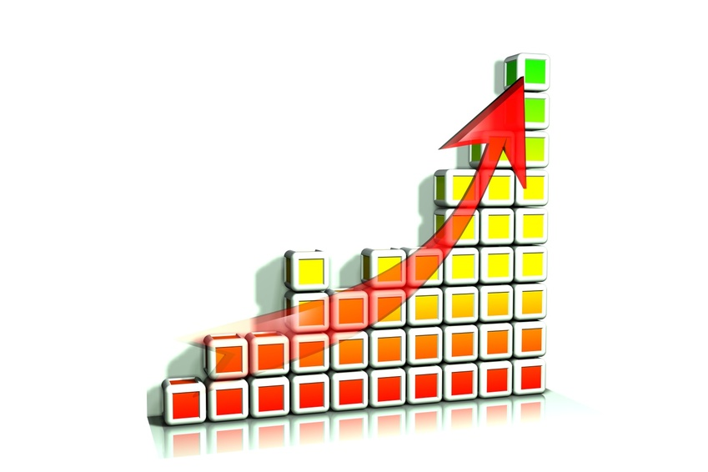
Prefer quantitative over qualitative information
Notes:
Tend to rely heavily on quantitative data, suggesting a single outcome, and dismiss validity of qualitative data.
Quant data thus suggest certainty, qualitative data require discussion to understand and interpret.
You need both to understand change fully.

Slide 14
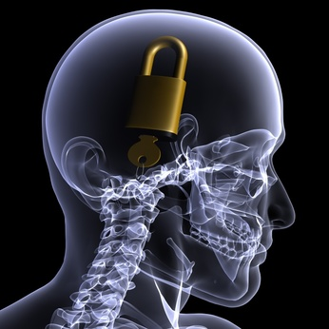
Don’t challenge individual and organisational assumptions about the future
Notes:
Miss potential innovation and strategic options because they don’t challenge organisational assumptions and ideologies about doing business now and into the future.
Ignore the opportunity to spend some time in the future to test whether what they do today will be relevant in that future.

Slide 15
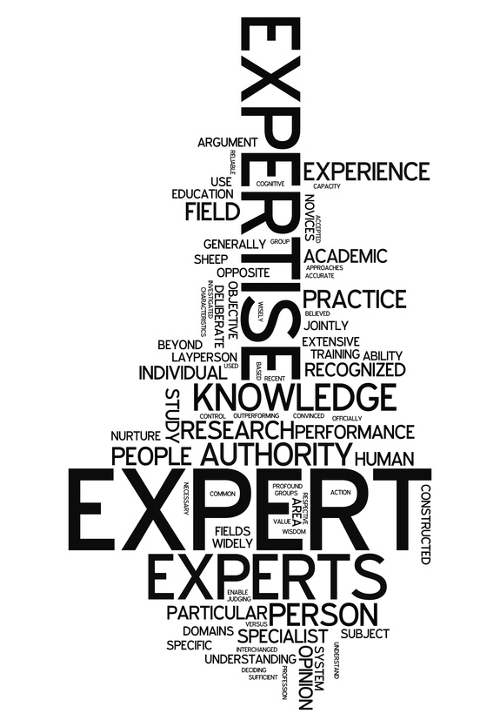

Rely on experts and/or downplay or dismiss staff beliefs, hopes and fears about the future
Notes:
And, they usually don’t include any systematic processes for listening to the views of staff, before a plan is written.

Slide 16
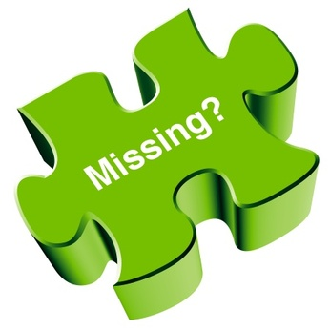
Traditional planning are approaches increasingly irrelevant
Focus on data at the expense of strategic thinking
View the plan as the end game
And don’t systematically and deeply consider possible futures
Notes:
Our current approaches don’t seem to be working anymore
While the need for planning has never been greater, the relevance of most of today’s planning systems and tools is increasingly marginal (Fuller, 2003).
It may well be that the typical strategic planning exercise now conducted on a regular and formal basis and infused with quantitative data misses the essence of the concept of strategy and what is involved in thinking strategically (Sidorowicz, 2000).
A major assumption of the strategic planning literature … is that all of these terms [strategy, planning] necessarily go together. [That is] Strategy formation is a planning process, designed or supported by planners, to plan in order to produce plans” (Mintzberg, 1994).
The literature also suggests that strategy often fails even after extensive ‘planning because of the inability of organisations to read signals of change and discontinuity in the external environment. That is, they didn’t scan.
Strategy is about the future. If our planning systems don’t include a step where the future is considered, it should be no surprise that strategy often fails when it actually connects with the future.

Slide 17
Frameworks for Challenging
Notes:
Foresight is not the only framework available for challenging conventional thinking and moving us beyond the status quo. Here are a few.

Slide 18
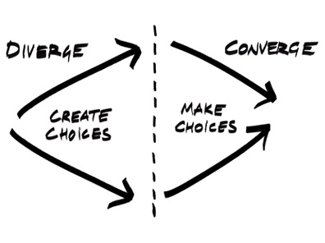
This is where we usually start thinking about the future, so what do we miss?
http://thinkbig-lab.com/wp-content/uploads/2011/07/picture-26.jpg
Notes:
All these frameworks seek to move us to new thinking spaces, beyond the status quo, beyond the conventional.
The aim is to create divergence in thinking to identify a wider range of choices than were apparent before – it is about moving beyond the boundaries of conventional knowledge into the realm of what we don’t know we know.
Then moving to the process of converging that thinking to what is realistic and feasible to implement today.
If we start with what we know about the past and present, and not explore beyond that into possible futures, we will be creating strategy that is more of today – and that is unlikely to be useful.

Slide 19
Foresight Methods

Slide 20
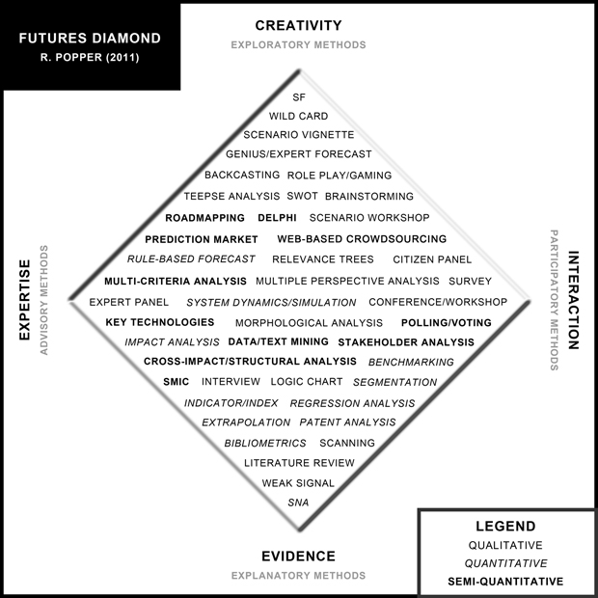
The Foresight Diamond http://www.futuresdiamond.com/en/the-diamond
Notes:
The foresight toolbox is full. Not all these methods are unique to foresight – all help in one way or another to explore the future.
Creativity based: original/ imaginative thinking
Expertise based: experts in particular area
Interaction based: bringing experts together and/or crowdsourcing approaches
Evidence based: quantitative, forecasting a particular phenomenon

Slide 21
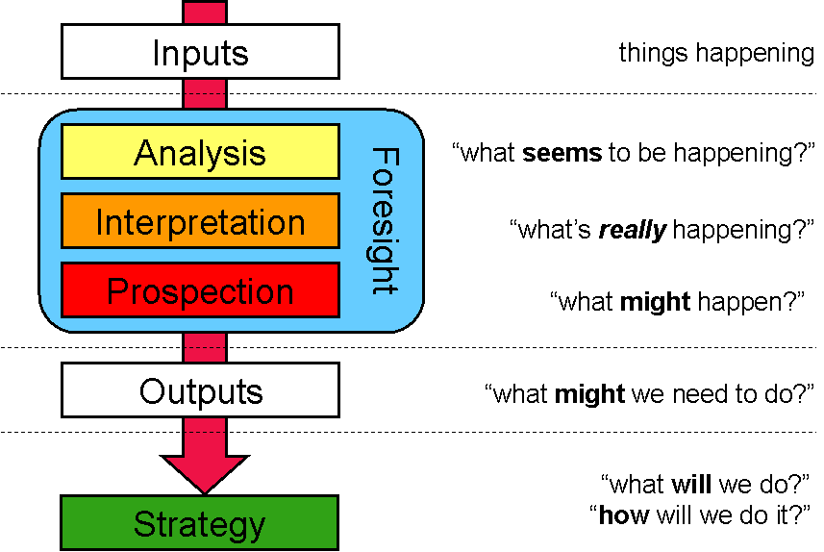
Generic Foresight Process
Notes:
The Generic Foresight Process developed by Joseph Voros while we were working together at Swinburne University of Technology is the framework I use for ensuring I follow a deep foresight process and select methods relevant to each stage of the process.
This diagram makes it look linear and but iterative, and independent in reality.
EXPLAIN
Okay, let’s look at each method group individually.

Slide 22

Input Methods
Provides high quality information to inform your strategic thinking.
Industry trends and global forces of change that are shaping the future of your industry.
Notes:
Provides the raw information to inform your thinking about what’s happening in the external environment today AND how it will evolve into the future.
Never kid yourself that your thinking is strong enough to not need informing. Every organisation needs to scan systematically and on a continuing basis to understand what’s coming and to recognise the early warning signals of change.

Slide 23
Strategic scanning happens at the global level – what are the forces shaping the change you are seeing in your industry?
Global Drivers of Change
Industry Trends
Your organisation
You know a lot about this – it is the change already here that you deal with every day.
Notes:
There are two levels to the input stage. You are looking for information about the forces of change shaping your industry.
Scanning at the industry level typically takes the form of competitor or competitive analysis, market analysis, benchmarking etc. You can get this information quite readily.
There are no benchmarks for the future, however, so identifying the change forces most relevant for your organisation is the first step in a foresight process.

Slide 24
Input Methods
Environmental (Horizon) Scanning
Delphi (expert based or crowdsourced)
Done a lot today, but often not broad or deep enough, reinforcing rather than challenging status-quo thinking
Notes:
The two main methods I use are scanning and Delphi.

Slide 25
Most scanning
is here
Look here for
today’s info
Look on the fringe as well
Global, multiple dispersed cases, trends and megatrends
Government Institutions
Newspapers, magazines, websites, journals,blogs
Late Majority
Number of cases; degree of public awareness
Scientists, artists, radicals, mystics
Laggards
Mainstream
Late Adopters
Trends
Few cases,
local focus
Emerging Issues
Early adopters
Innovators
Today
Time
Time from emerging issue to mainstream varies between 18-36 years
Adapted from the work of Graham Molitor and Wendy Schultz, and Everett Rogers

Slide 26
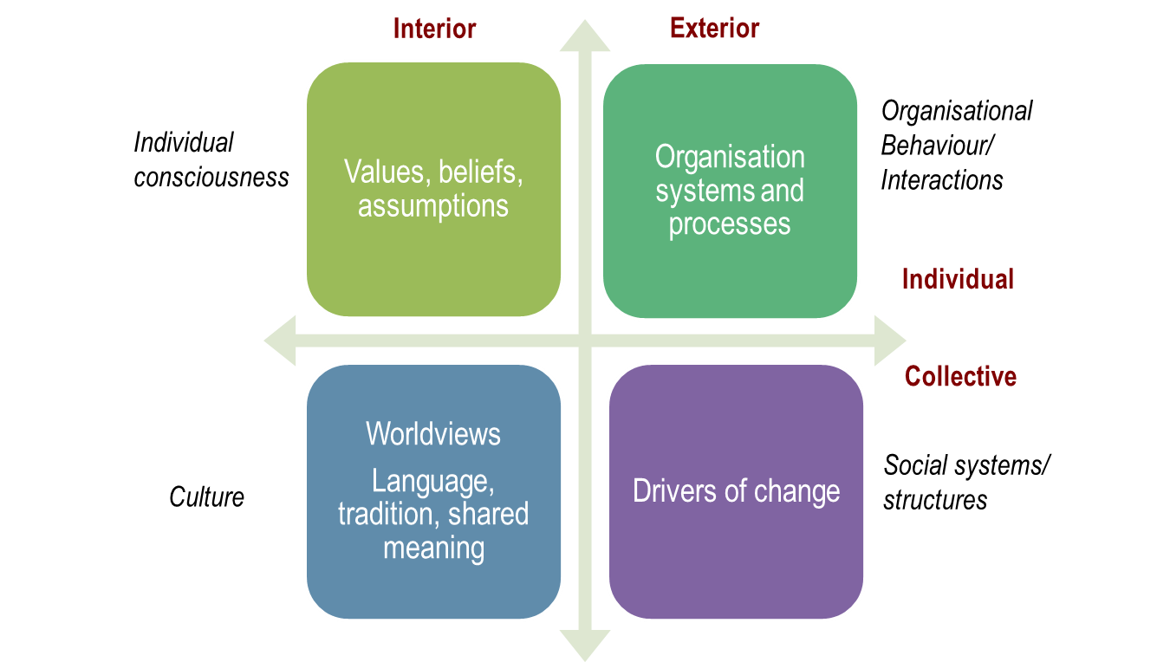
Integral Scanning
Individual: Individual Values and Psychology, Development of Consciousness
Communal: Group Values & Mores and Cultural shifts
Objective: Scientific, Technical, and Measurable trends/forces
Social: Economic, Ecological, and Political trends/forces
Notes:
Apply the integral framework I mentioned earlier to scanning gives you an idea about the importance of taking a holistic perspective.
Concentrate on the right hand side and you will capture half the story. People implement change, and so you must spend time scanning on the left hand side to be able to build the complete story about change influencing your organisation.

Slide 27
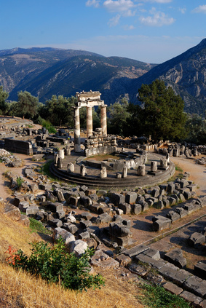
Delphi
Developed by Rand Corporate in 1970s
Used extensively (Japan has long history)
Brings expert opinion together, seeks consensus on forecasts
Traditional version takes months and several rounds
Now real time Delphi, immediate, one round usually
http://www.millennium-project.org/millennium/RTD-general.html
http://shapingtomorrow.com
Remember, expert opinion is only one input.

Slide 28
Expert Judgements
“Inventions have long since reached their limit, and I see no hope for future development”
Roman engineer Sextus Julius Frontinus, 1st Century AD
“Heavier than air flying machines are not possible”
Lord Kelvin, President of the Royal Society, 1895
“We don’t like their sound, and guitar music is on the way out”
Decca Recording Co. rejecting The Beatles, 1962
“The fact that conflicts [producing civilian casualties] have been conducted away from the U.S. homeland can be considered one of the more fortunate aspects of the American experience.”
Quadrennial Defense Review (QDR) for the US Dept of Defence, 2001
Notes:
Introduce these by saying nothing and just letting people read them. There will shortly be some laughs, which is the idea. Wait a minute or so until everyone has read them, then comment on each. Wright Bros; Yuri Gargarin; Beatles, etc. “I also usually put in one by Bill Gates in 1982: “640K of RAM ought to be enough for anybody…”
All of these people were experts in their fields; not stupid, just too expert for their own good.

Slide 29

Analysis
Looking for patterns and themes relevant for your organisation.
Organising and presenting the inputs for your organisation.
Notes:
Analysis is about working out what’s relevant and important for your organisation. What really matters?
It’s also about organising and presenting the information so it makes sense for your organisation.

Slide 30
Analytic Methods
Trend Analysis
Emerging Issues Analysis
Cross Impact Analysis
Futures Wheel
Forecasts
This set of methods are well understood, but people can get trapped by data
Notes:
You are probably familiar with most of these methods.

Slide 31
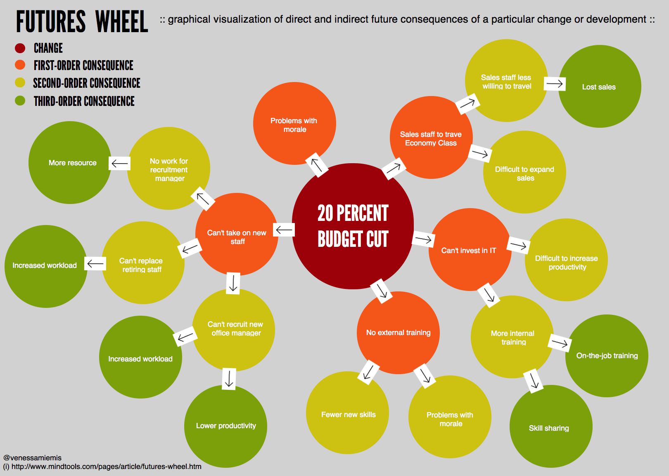
Futures Wheel
http://emergentbydesign.com
Notes:
Developed by Jerome C Glenn in 1971 at Antioch Graduate School of Education.
Approach for exploring possible impacts of trends now and into the future.
Projects possible cause and effect relationships between a trend and the changes that could ripple out from it.
Clarifies connections/correlations between trends –but, not necessarily cause and effect.
Identifies issues that may need to be addressed today to prevent an undesirable outcome.
Identifies issues that need to be influenced today to ensure positive outcome.

Slide 32

Interpretation
System structure and dynamics
whose beliefs are dominant?
what’s driving and shaping the trends?
how will they develop?
and what does it mean for us?
This stage needs time for thinking and conversation
Notes:
This level is about system dynamics – and about meaning.
Assumption walls pop up here – what a trend means to one person will be different to another.
Aim to build a shared view of the shape of the future for your organisation.

Slide 33
Interpretation Methods
Causal Layered Analysis
Systems Thinking
Hardest level because it needs open minds and people willing to have their assumptions challenged.

Slide 34
Causal Layered Analysis
Visible
Short Term
Litany
Social Causes
Discourse/Worldview
Metaphor/Myths
Hidden
Long Term

Slide 35
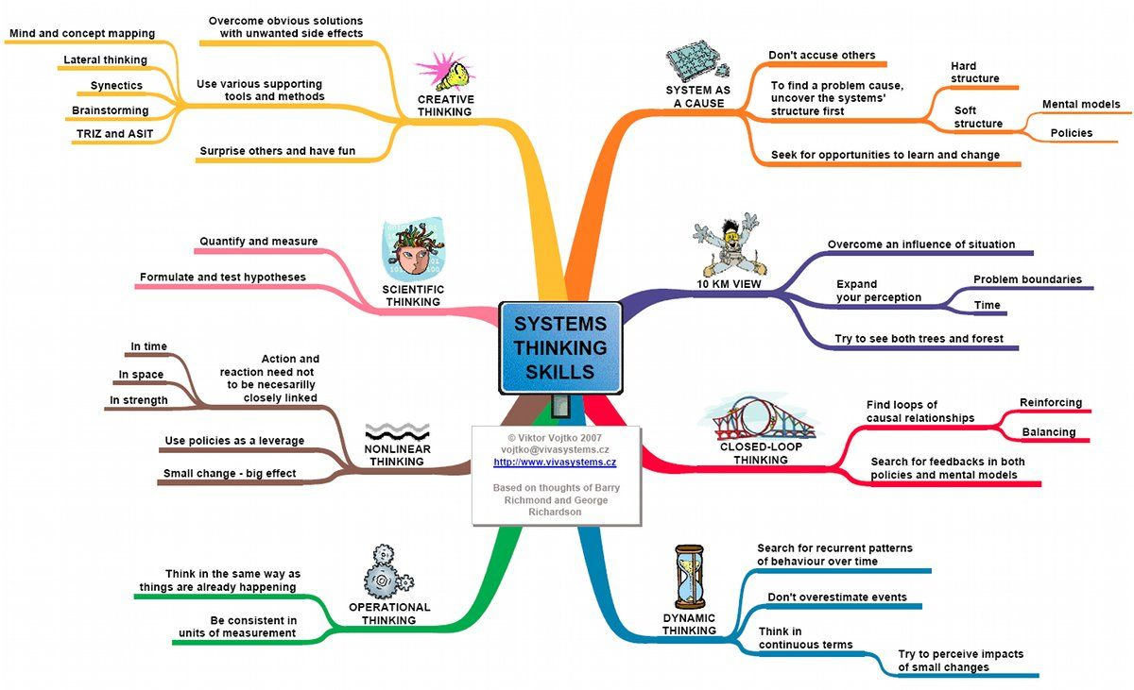
Systems thinking
Notes:
Systems thinking is the critical capacity that underpins all foresight methods.
Taking the holistic approach to deepening your understanding of change is critical if you are to develop a robust understanding of what your options are for the future of your organisation.
I’m not going to spend any time on systems thinking here, but you will see it highlights a number of key concepts:
Different ways of thinking – dynamic, creative, scientific, non-linear and operational – we need them all
The 10KM view – the helicopter view – moving out of organisational silos to understand how you connect with the world
And causal relationships – understanding how one part of the system influences another
This is why what is call trendwatching is pointless unless it’s considered in a system. Forecasting a trend in isolation is a recipe for a flawed strategy.

Slide 36
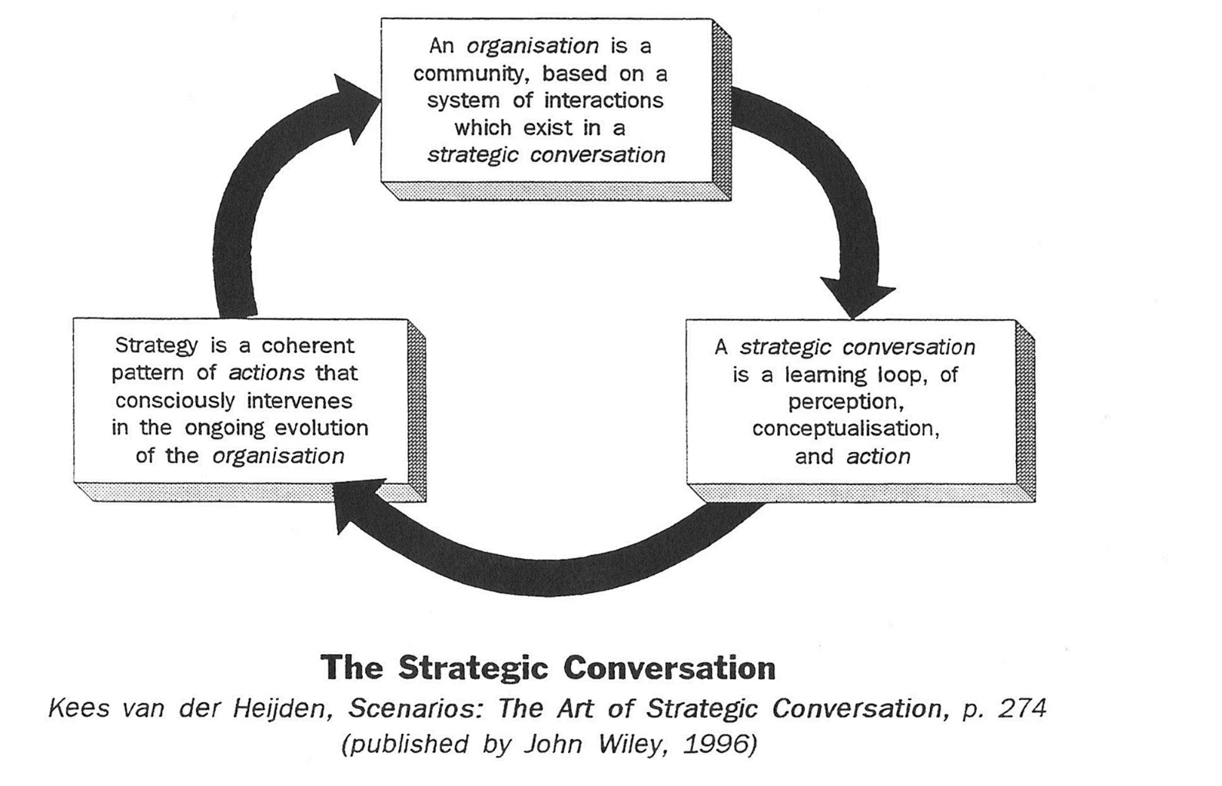
Strategic Conversation
Notes:
This diagram comes from Kees van der Heijden – for me the point is that the strategic conversation about the future is going on all the time, informing strategy interventions in, as he calls it, the ongoing evolution of the organisation.
This thinking is in contrast with conventional approaches which have strategic conversations happen as part of the annual planning cycle or at the planning retreat.
Finding the time to think about the future and share that thinking across the organisation is the biggest challenge for foresight work.

Slide 37

Prospection
How will change evolve over the next 10-20 years?
How might we respond? What are our options?
Often dismissed as fluffy because there is no ‘evidence’
Notes:
Scenario planning is a way to challenge our thinking about linear futures
Visioning helps us to create an image of a future destination and to start to operationalise that in our strategic planning.
Backcasting is a process where we start in our preferred future destination and work backwards

Slide 38
Prospective Methods
Scenario Planning/Thinking/Learning
Backcasting – linked with scenarios
Visioning
Scenarios frequently used, but frequently done badly (superficial, don’t challenge assumptions)
This set of methods tests people’s ability to move beyond today

Slide 39
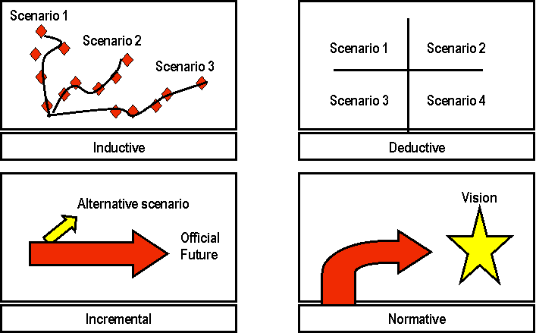
Scenarios

Slide 40
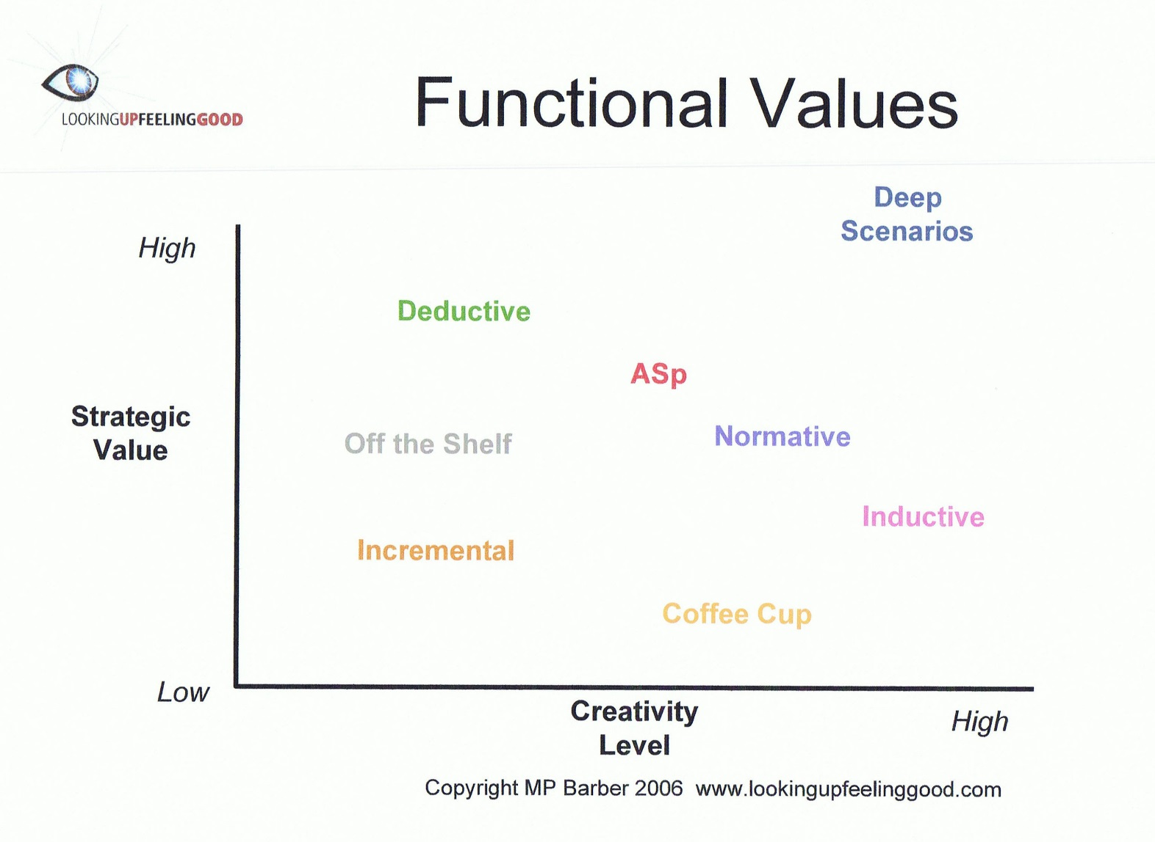
Scenario Types

Slide 41
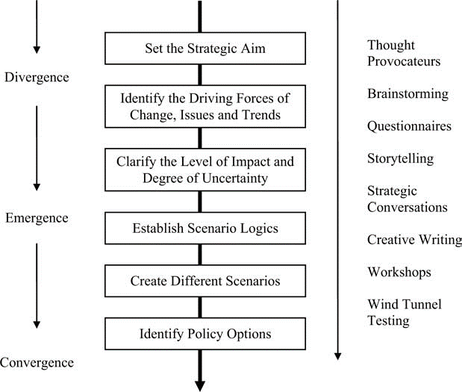
Scenarios
http://www.thefuturesacademy.ie/

Slide 42

Visioning
Preferred future for an organisation.
Developed after exploring alternative futures.
Long term, aspirational, stable. Pulls people into the future.
Notes:
Visions have a bad name, but they are essential in terms of communicating a preferred future for an organisation. Everything that goes into a strategic plan must, in some way, help the organisation achieve its vision.

Slide 43

Back to Work
http://arttattler.com/archivedisneyfamilymuseum.html

Slide 44
When and where to use?
Context matters – methods must be chosen and tailored to your organisation.
Foresight maturity of your organisation – the methods you use if you have never used foresight before will be different to those you use after doing foresight for 5 years, 10 years…
Foresight Maturity Assessment available at http://www.foresightalliance.com/resources/foresight-maturity-model/

Slide 45
When and where to use?
Decisions about foresight methods are based on these factors:
Purpose
Using Outputs
Resources Available
Major issues that you need to explore (the future is a big place)
Internal champion and support of CEO
Notes:
Why you are doing foresight in your organisation? What do you hope to achieve?
How are you going to use the outputs of your foresight process – that is, where does it fit with your existing strategic processes?
How much can you invest in terms of resources – financial, human and time?
What are the major issues about the future of your organisation that you need to explore?
Do you have a champion?

Slide 46
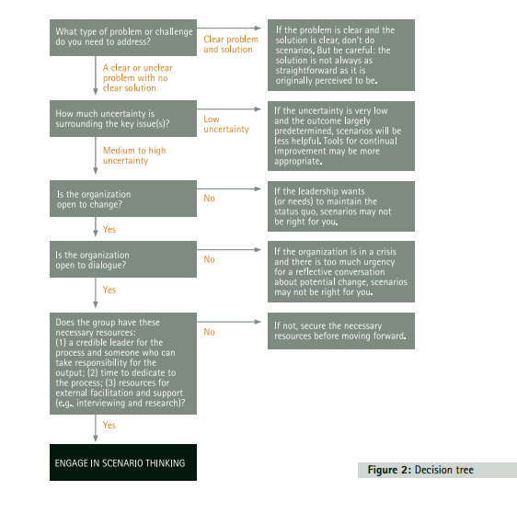
This decision tree relates to scenarios but it’s relevant for all decisions about which method to use when.
http://www.monitorinstitute.com/downloads/what-we-think/what-if/What_If.pdf
Notes:
Foresight isn’t always the answer.

Slide 47
A final word
There are many organisations in the world that use foresight in one way or another in their strategy processes.
Some are successful, (particularly in Europe) ,others once were (Nokia), and some missed the boat altogether (Kodak).
Your time is better spent thinking about how to contextualise methods for your organisation, rather than seeking benchmarks and case studies.
Notes:
The key element in whether foresight processes will be successful is the thinking capacity of the people in an organisation and recognition that the future is an essential element in strategy formulation.
This is why case studies and benchmarking aren’t terribly useful – in an integral sense, foresight methods and processes are in the right hand quadrants, the visible and the measurable and this is what we document in case studies.
Documenting the shift in thinking that embeds foresight processes into organisational strategy is a different thing. The contextualising of foresight is the first step.

Slide 48

Questions/Discussion

